Slide 1
UNDERSTANDING DATA
PRESENTED BY
DHANUNJAY VALLURU P.J. PREETI
SHIVAM TOMAR ARPITA SRIVASTAVA
PRIYANKA GILL PRIYANSHU SINGH
VITAN CHOPRA HARE KRISHNA SHAh
DEEPTHI KONDAVEETI SWATHI YADLAPALLI
RESHMA

Slide 2
ASSIGNMENT-1
USE THE DATA TO PRESENT HOW THE EDUCATION INDUSTRY AND FIELDS OF STUDY HAVE BEEN IMPACTED OVER THE YEARS.
GIVEN DATA SET - UDEMY COURSES
DATA CLEANING : Data cleaning is the process of fixing or removing incorrect, corrupted, incorrectly formatted, duplicate, or incomplete data within a dataset.
ANALYSING DATA : The main purpose of data analysis is to look at what the data is trying to tell us. ... Observations: the type of data given to us involves observing the education strategy by the udemy courses.
DATA VISUALIZATION : Refers to representing data in a visual context, like a chart or a map, to help people understand the significance of that data.

Slide 3
Correlating data :Correlation is a statistical measure that indicates the extent to which two or more variables fluctuate together.
INITIAL OBSERVATIONS OF THE GIVEN DATA SET
The price of the courses varied from 0-200.
There are courses with a minimum of 0 subscribers. The number of reviews are way lesser than the subscribers.

Slide 4
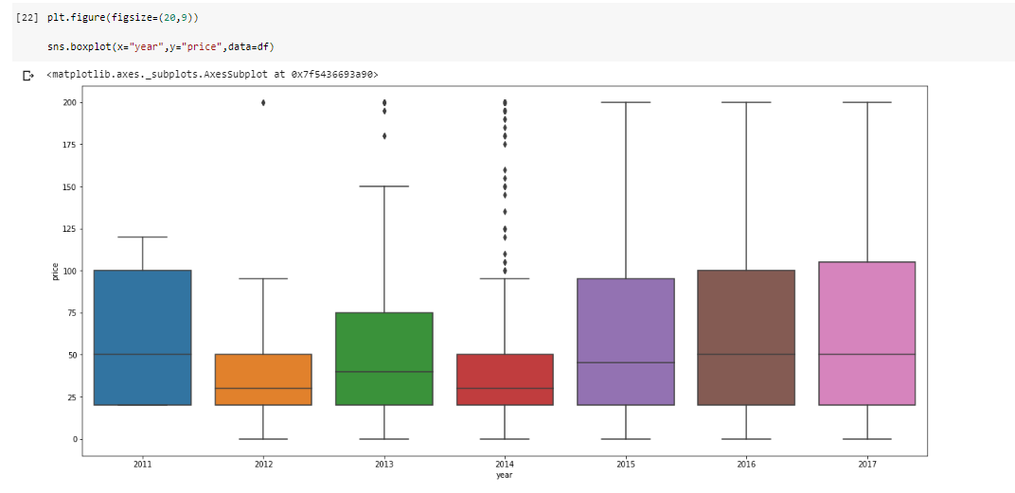
Correlation of price and year
According to the given plot, the courses of almost all prices, except a few, were at high demand in the year 2017.
Courses were at a higher demand in the year 2011 as well.
Most of the courses were bought at the price ranging between $25 - $105.
In 2012, the courses were bought at a price lower than the average price. As the year increased, the courses ranging from $50 -$105 were bought more frequently.

Slide 5
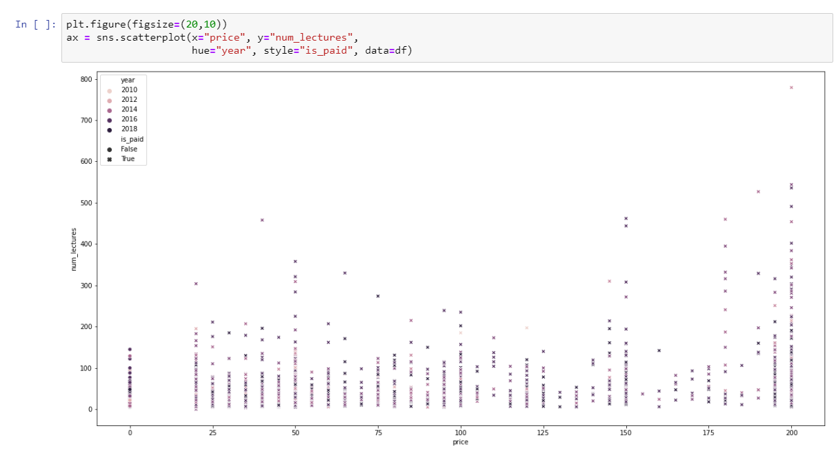
Correlation of price and number of lectures
Courses having number of lectures from 1-200 are at higher need for all prices. Most of the courses bought are at $200 for number of lectures ranging from 1-500.

Slide 6
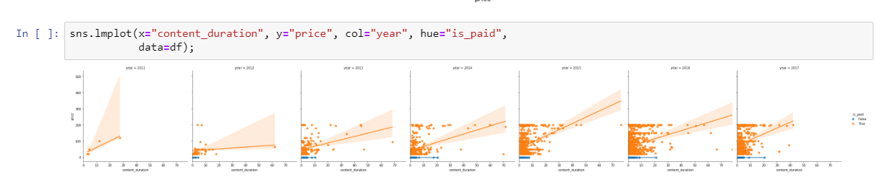
Correlation between price and content duration for each year
Content duration is directly proportional to the price of the courses.
More preference is given to the courses having lesser duration of the courses.
2015 onwards, most courses are bought with a price ranging from $10-$200 with a content duration from 2-20 hrs.

Slide 7
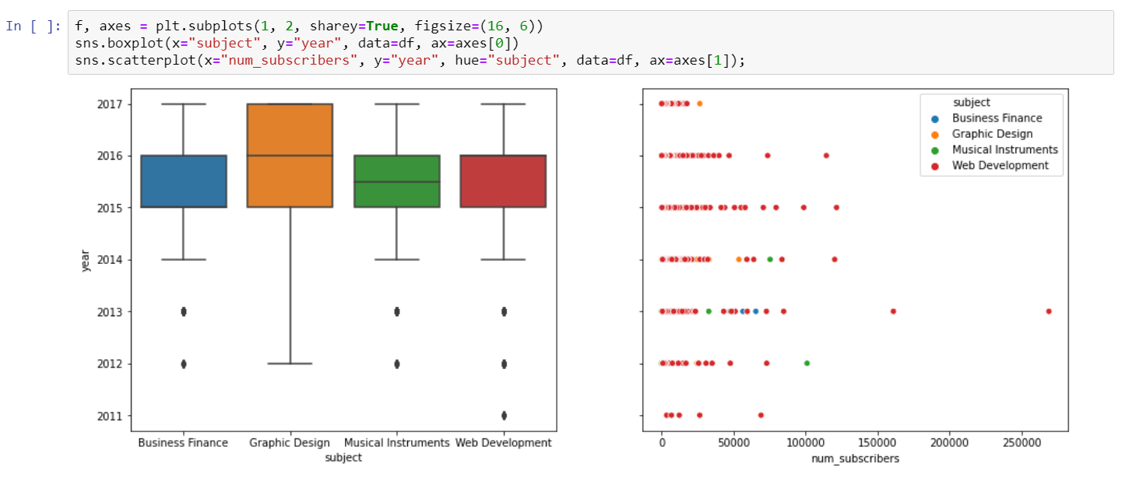
Correlation of price with subject and subscribers of each year

Slide 8
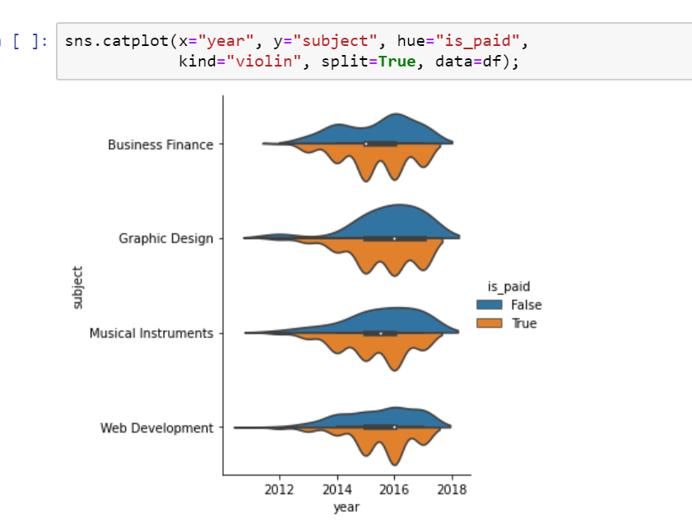
YEAR AND SUBJECT:
Graphic design was at highest demand from 2015 onwards.
The demand was almost constant for all the subject during the years 2015-16.
Web development has been in demand since 2011.
So according to the given plot we can observe that as the years have gone by, the demand for the subjects has also increased.

Slide 9
YEAR AND NUMBER OF SUBSCRIBERS:
According to the plot we observe that web development has had the highest number of subscribers from 2011-17.
Also, as the years increased the subscribers of web development have increased till 2016.

Slide 10
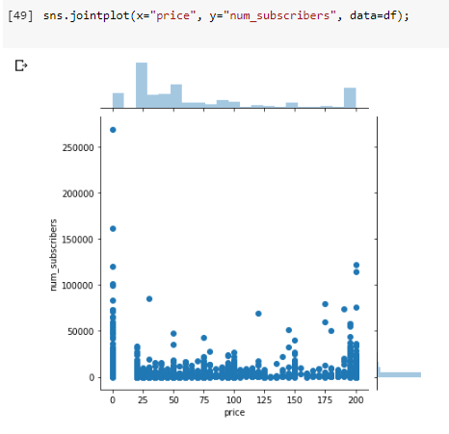
Correlation between number of subscribers and price
Here,
We can observe that most of the people have subscribed to unpaid courses.
At all costs we see that there is about 25000 subscribers and the min amount of subscribers is 10.

Slide 11
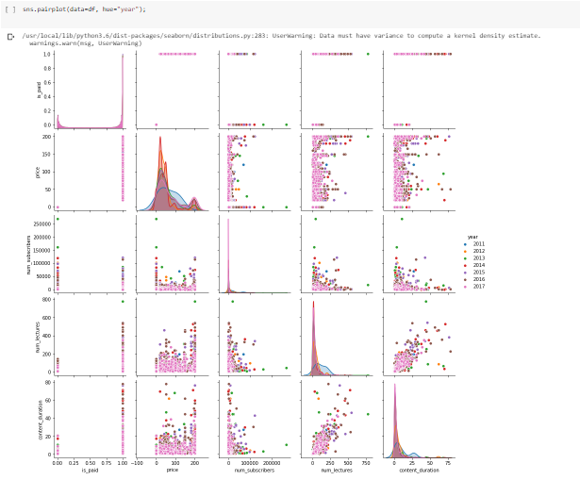
PAIR PLOTS FOR EACH YEAR

Slide 12
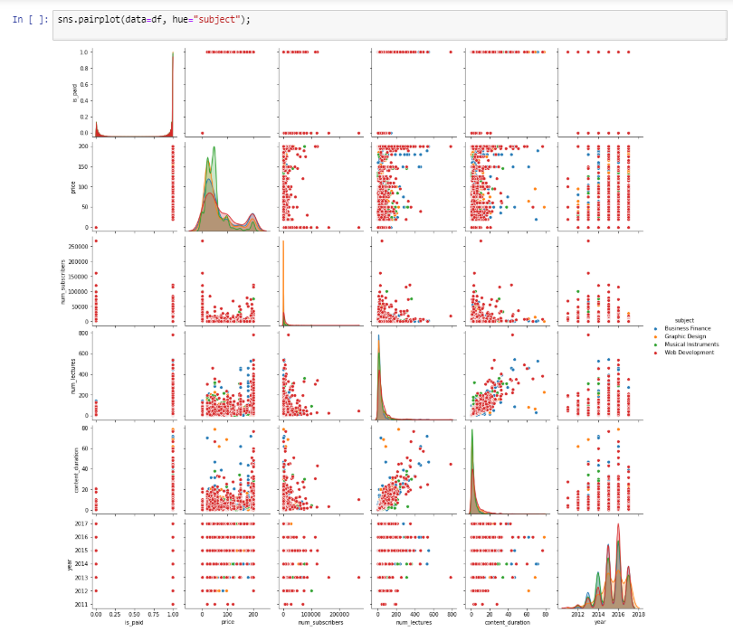
PAIR PLOT FOR EACH SUBJECT

Slide 13
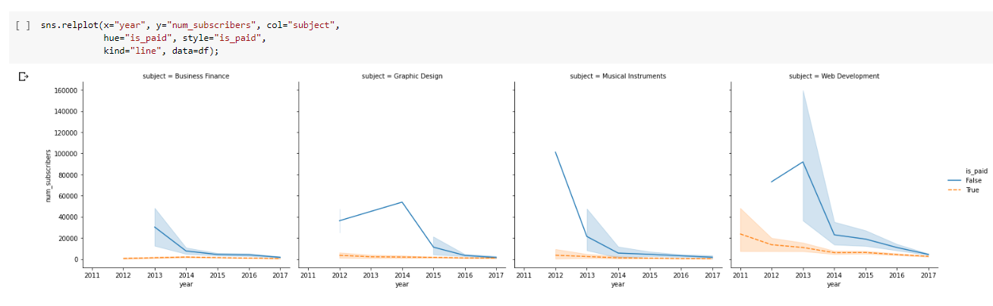
Correlation between subscribers and year for each subject
So, we can observe in the above plot that web development has the maximum number of unpaid subscribers.

Slide 14
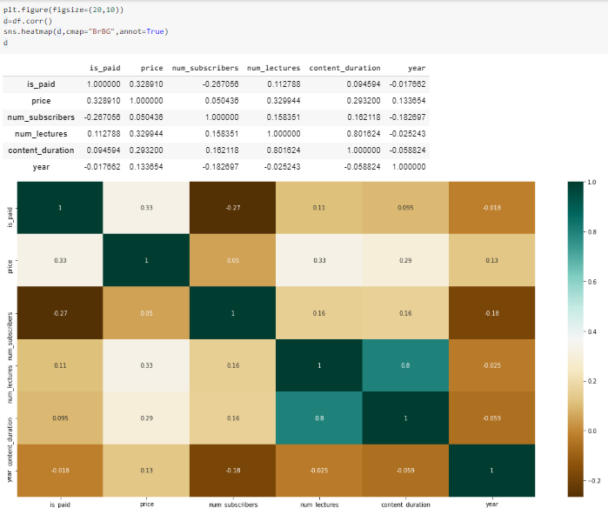
Correlation matrix of udemy dataset and heatmap for correlation matrix
+1 indicates a perfect positive linear relationship: as one variable increases in its values,the other variable also increases in its values via an exact linear rule.
–1 indicates a perfect negative correlation, meaning that as one variable goes up, the other goes down.
A value of zero indicates that there is no relationship between the two variables.

Slide 15
Analysing bigmart dataset

Slide 16
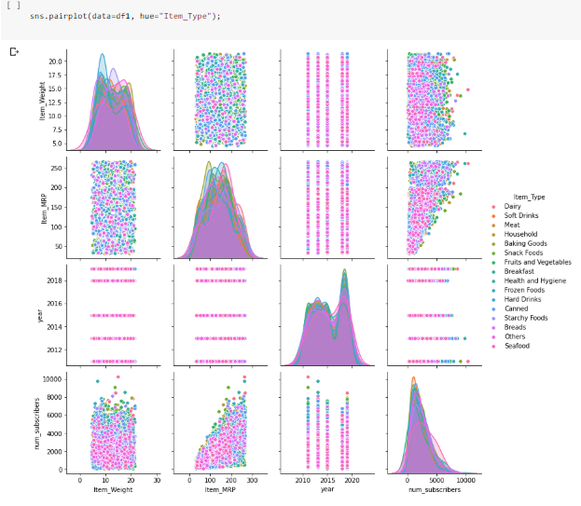
Pair plot for type of item

Slide 17
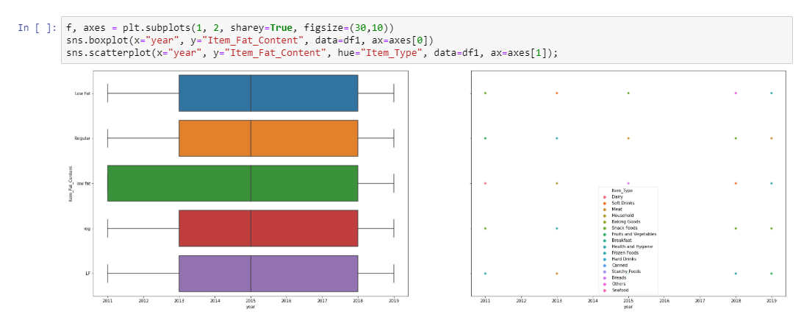
Correlation of fat content over the years
We see that people mostly preferred low fat content from 2011-18.
And there has been a constant and demand of others through the years 2013-18.

Slide 18
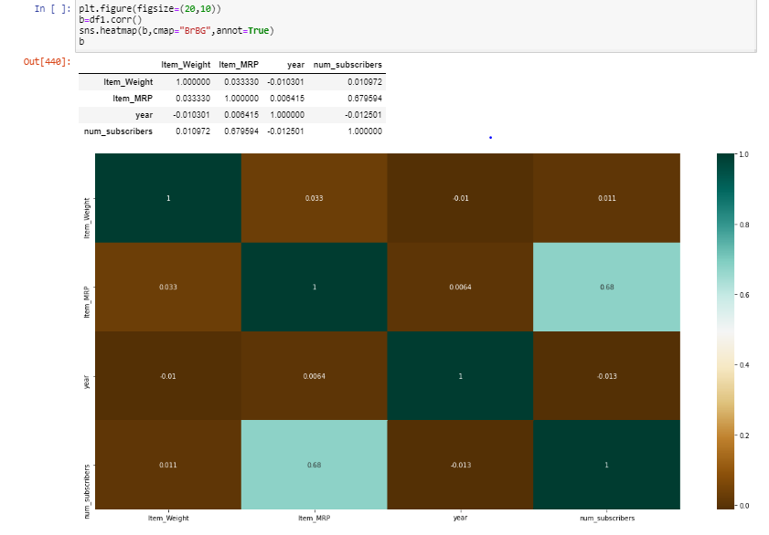
Correlation matrix of bigmart dataset and heatmap for correlation matrix
The p-value of 0.03 is less than the acceptable alpha level of 0.05, meaning the correlation is statistically significant.
Values between 0 and 0.3 (0 and -0.3) indicate a weak positive (negative) linear relationship via a shaky linear rule.

Slide 19
CORRELATING THE UDEMY AND BIGMART DATASETS

Slide 20
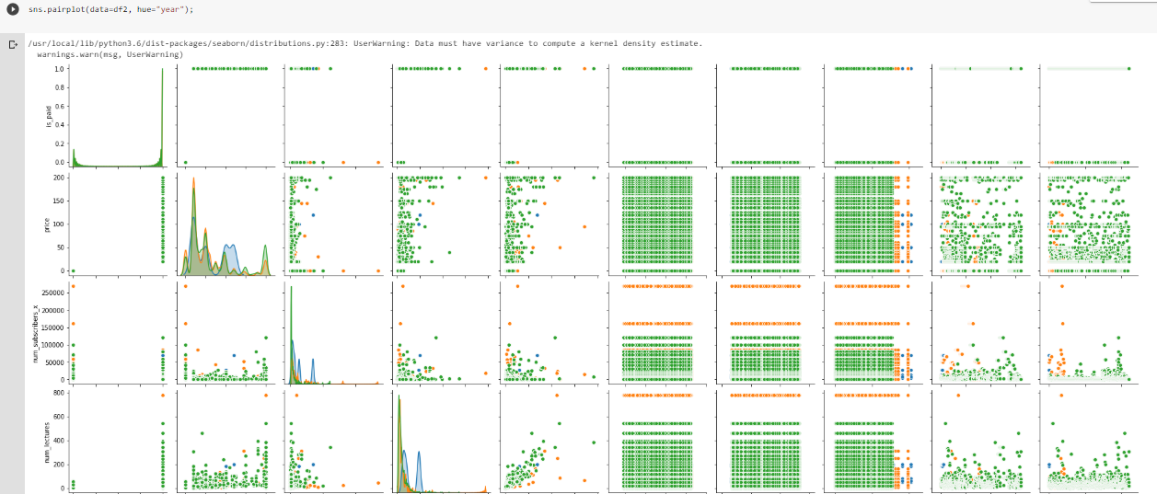
PAIR PLOT FOR COMBINATION OF BOTH DATASETs

Slide 21
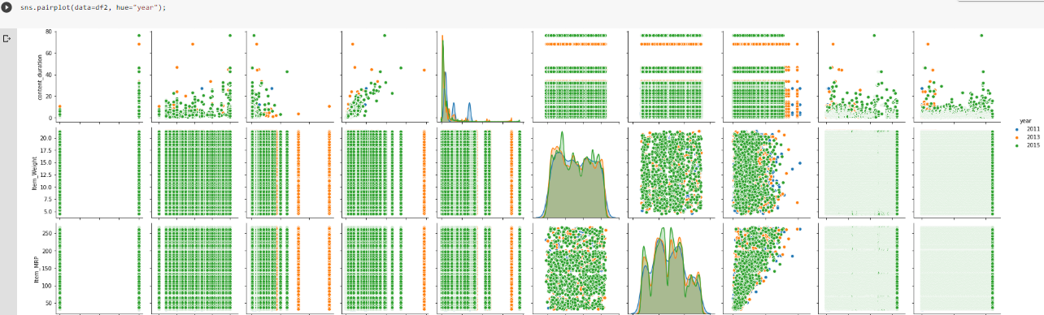
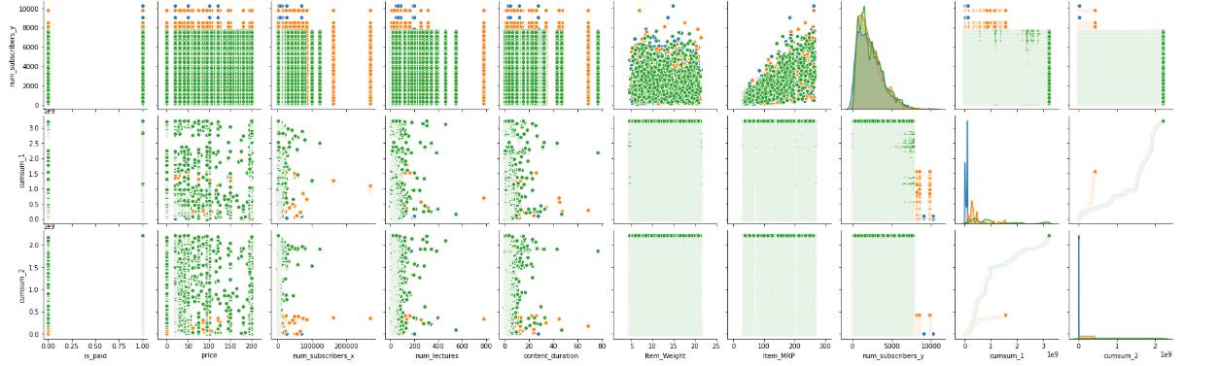

Slide 22
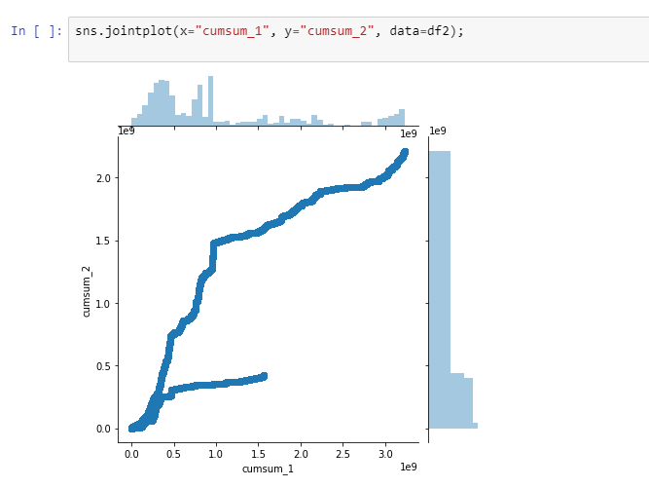
Jointplot of both the cumsum graphs
Pandas provides an easy-to-use function to calculate cumulative sum which is cumsum.
We have applied groupby function for years to the subscribers of each dataset.

Slide 23
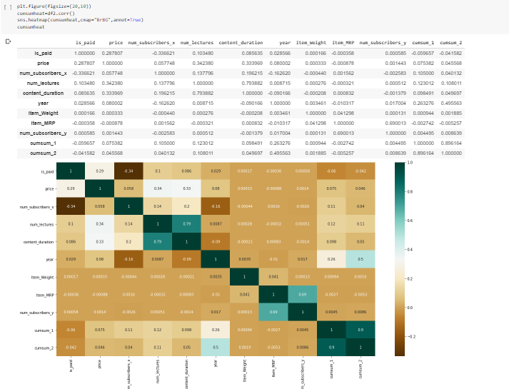
HEATMAP OF THE CUMSUM PLOTS

Slide 24
THANK YOU !

